Slide 1






Enhanced environmental protection inspection for efficient control of air quality monitoring and of all entities under obligation within system of greenhouse gas emission allowance trading, in order to achieve better quality of air in Republic of Croatia
This project is funded by the European Union

Slide 2



PARTICULATE MATTERS
Dr.sc. Krešimir Šega, dipl. ing. fiz. (u mirovini)
Jedinica za higijenu okoline, IMI-Zagreb
Opatija, 07.11.2017.

Slide 3

TWO-COMPONENT SYSTEMS
Continuous phase Dispersed phase
Hydrosol Liquid Liquid and/or solid
Foam Solid or liquid Gas/mixture of gases
AEROSOL Gas/mixture of gases Liquid and/or solid
Environmental air we observe as a complex aerosol
Continuous phase Dispersed phase
mixture of gases solid and/or liquid particles

Slide 4
TYPES OF PARTICULATE MATTERS
The individual particles: small amounts of the substance, of regular shape with a density close to inrtinsic density of the substance from which are made up
Aggregates: groups of particles that stick together with a powerful atomic and/or molecular forces. In the air behave like individual particles.
Agglomerates: groups of particles that stick together with a weaker forces adhesion or cohesion.
Floccules: groups of particles are related to each other even weaker forces, that are easy to break down by vibrations, air flow, etc. In the air behave completely differently than individual particles.
Fibres: natural (biological or mineral origin) or artificially manufactured fiber Condition: L > 5 µm; L/D > 3

Slide 5
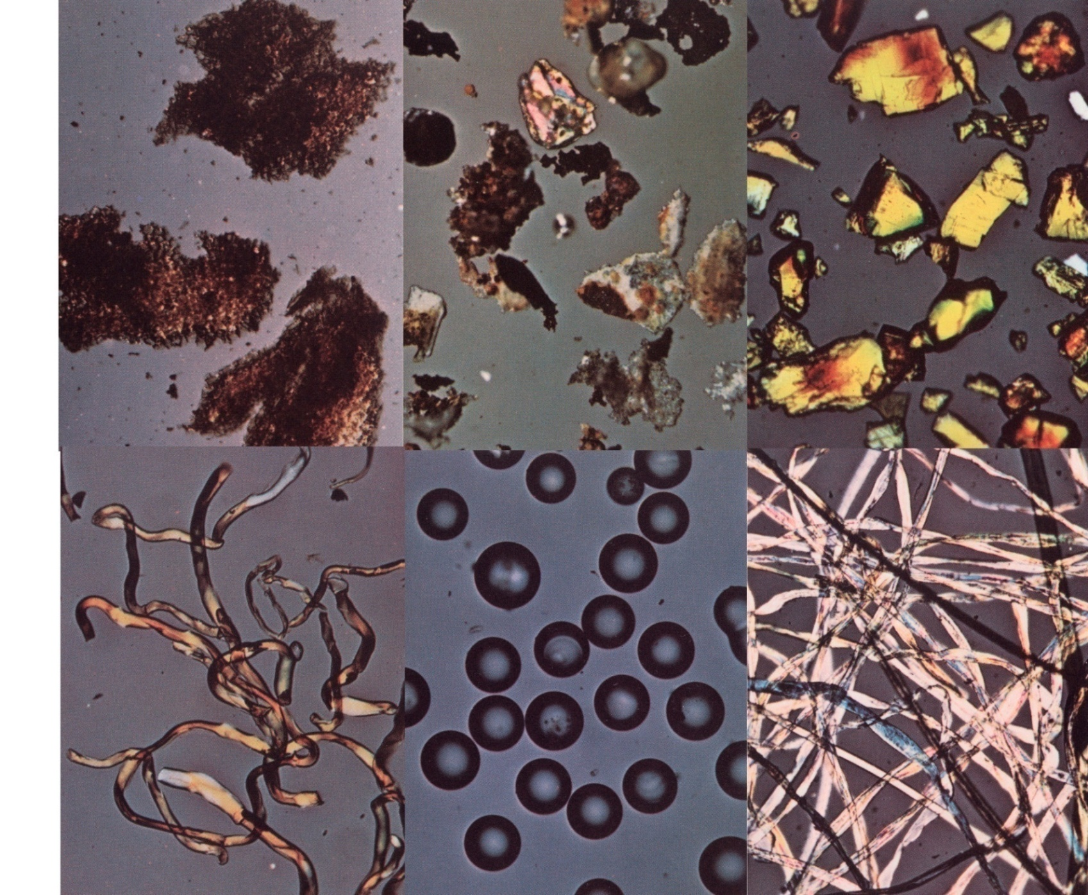
EXAMPLES OF PARTICULATES

Slide 6
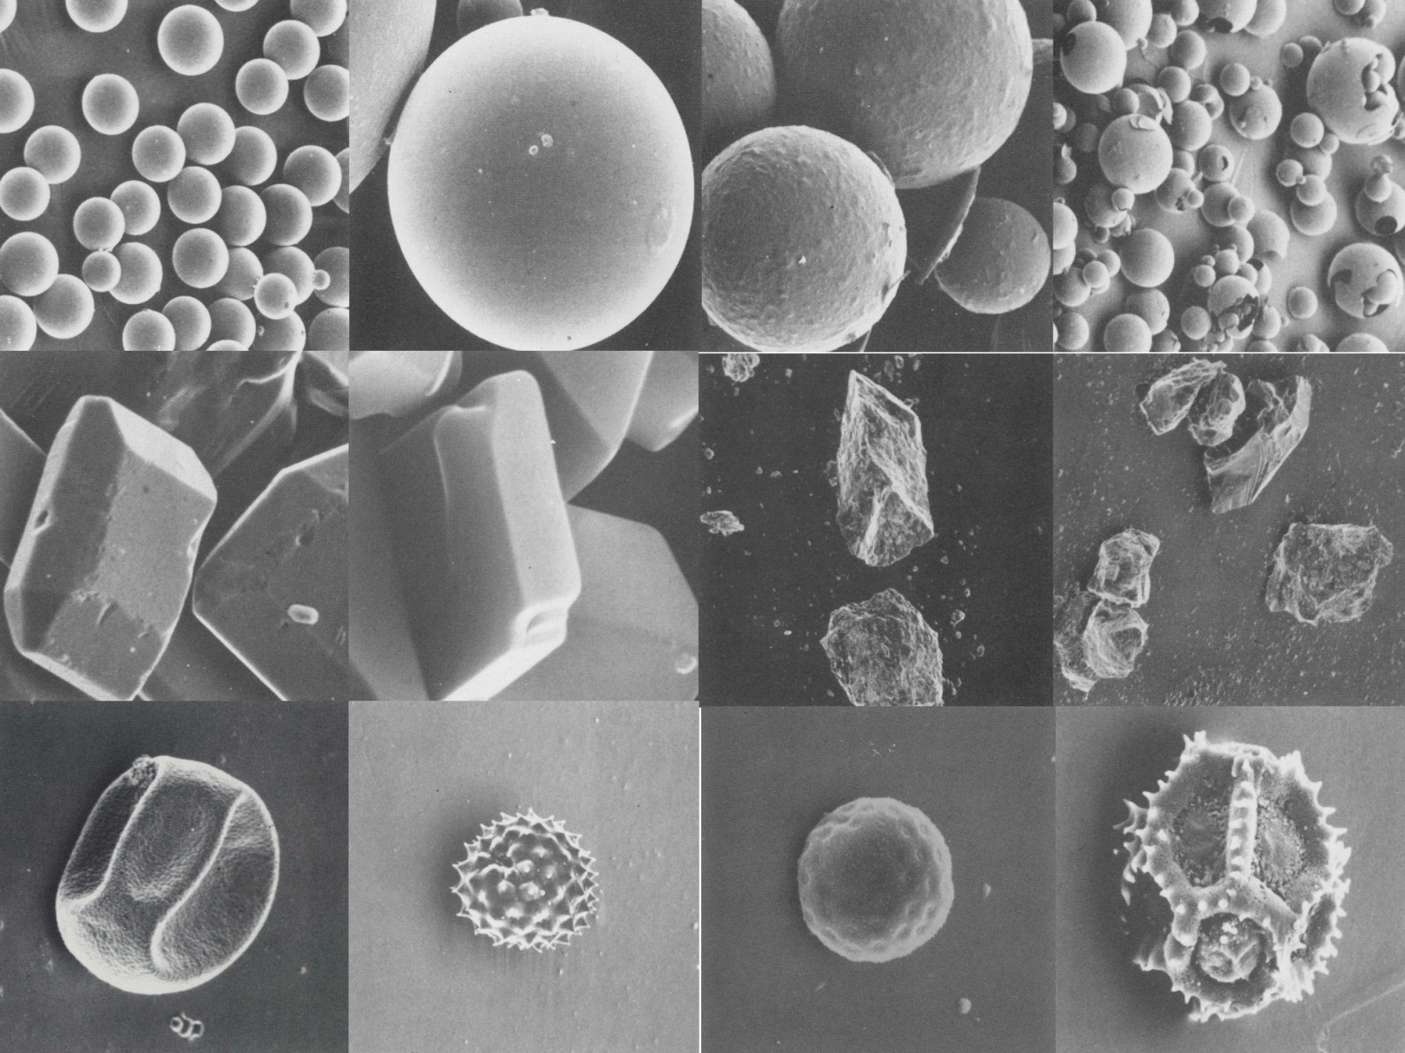
EXAMPLES OF PARTICULATES

Slide 7
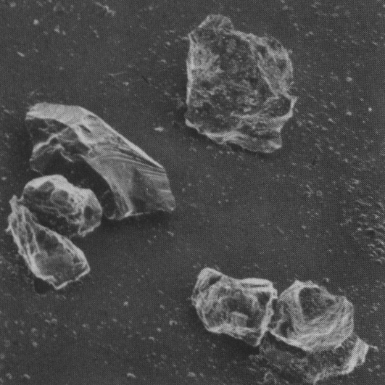
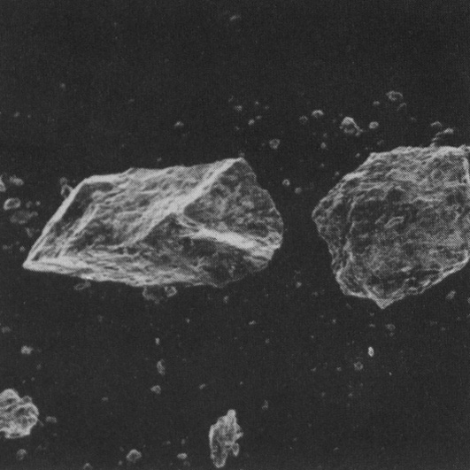
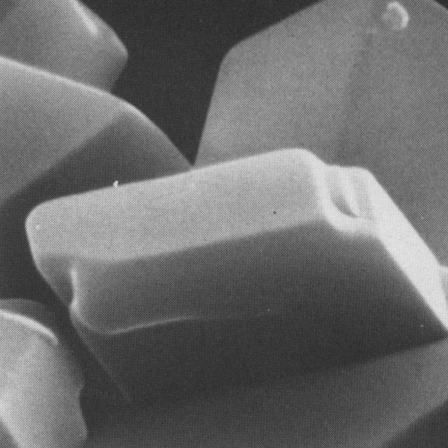
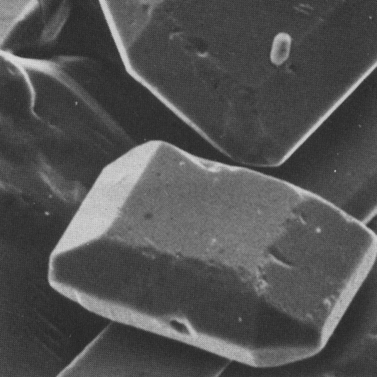
EXAMPLES OF INDIVIDUAL PARTICULATE MATTERS

Slide 8
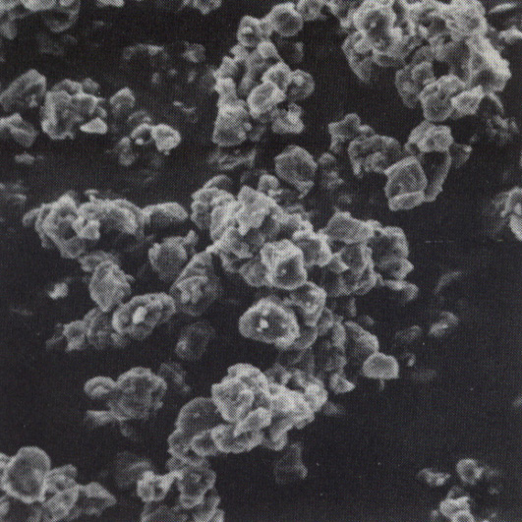
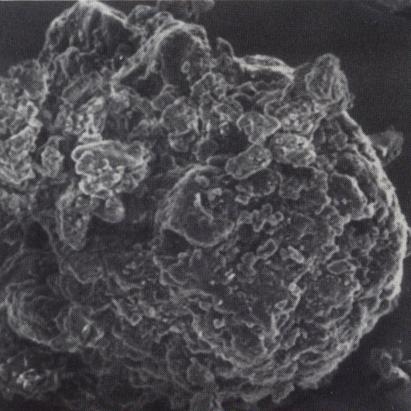
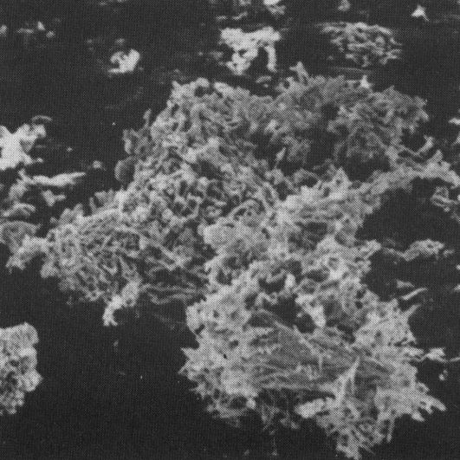
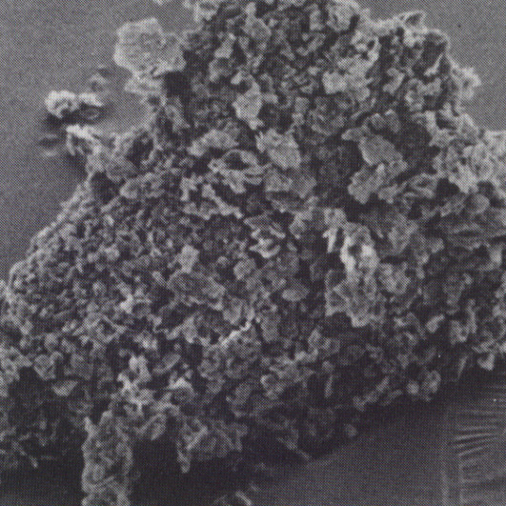
EXAMPLES OF AGGREGATES

Slide 9
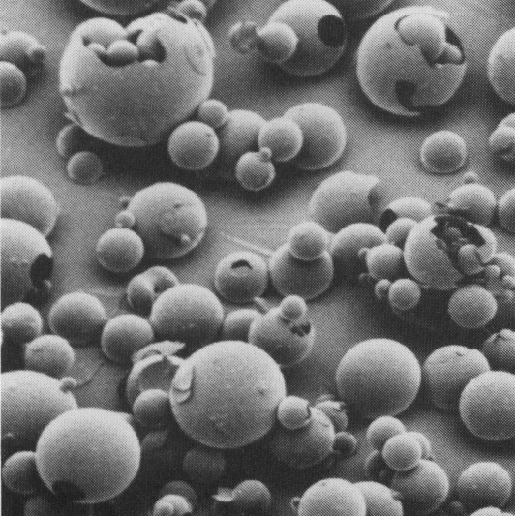
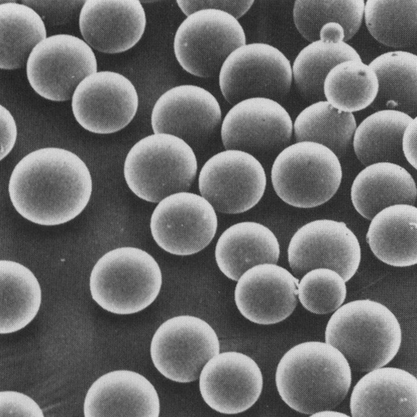
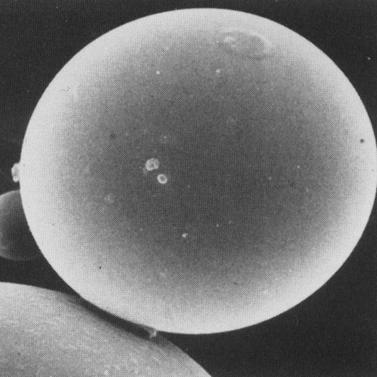
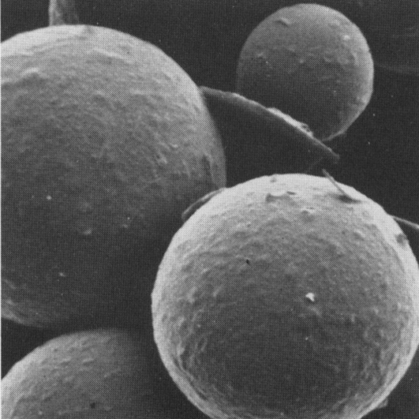
EXAMPLES OF SPHERICAL PARTICLES

Slide 10
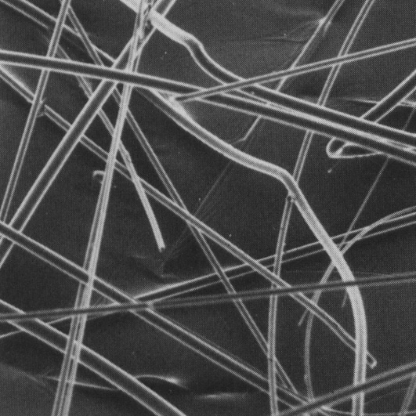
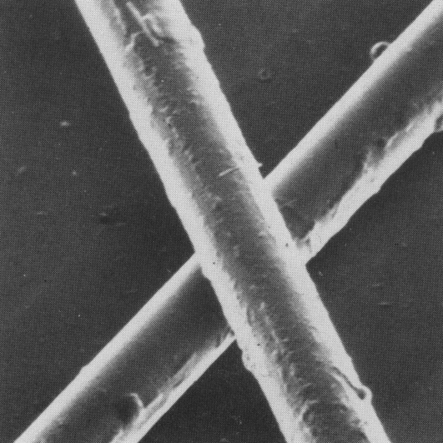
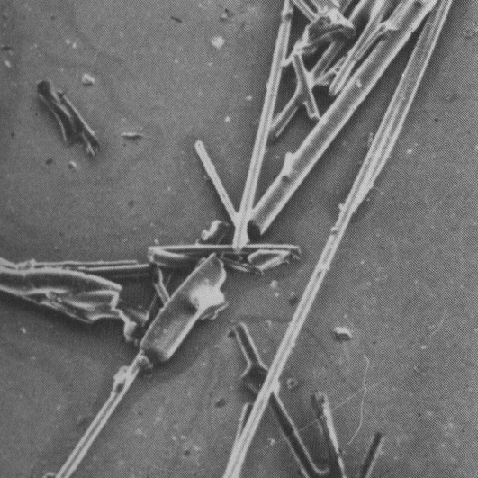
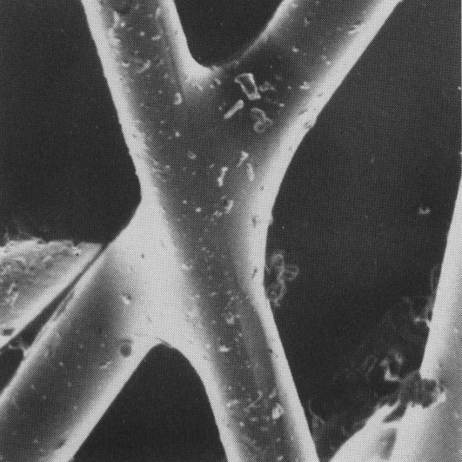
EXAMPLES OF FIBERS

Slide 11
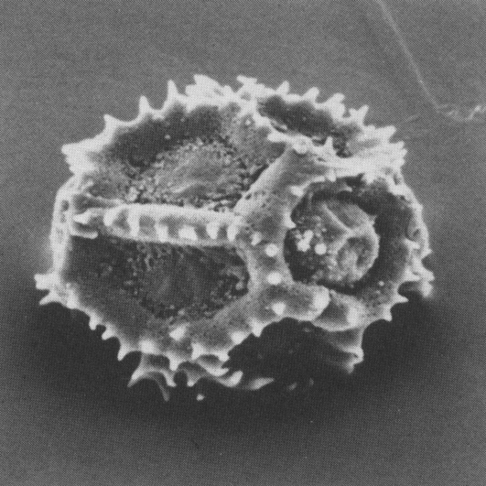
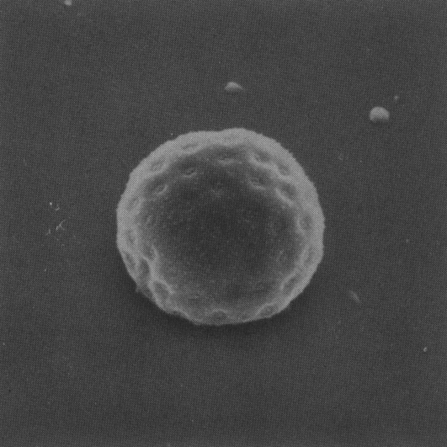
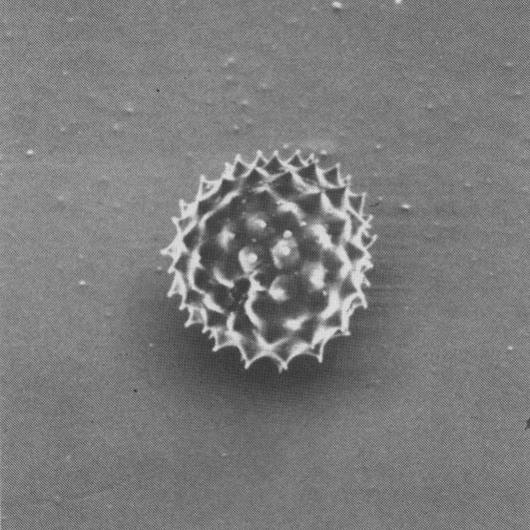
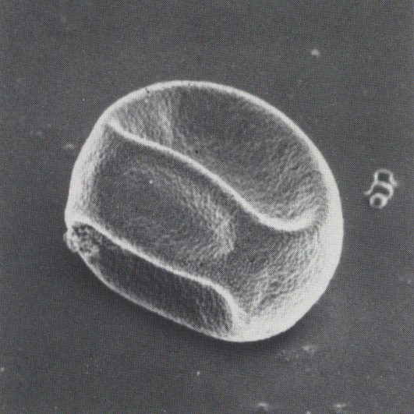
EXAMPLES OF POLLEN

Slide 12
WHAT AND HOW TO DO NEXT?
The different particle size
Different forms of particulate matter
The different composition of the particles
Different densities of the particles
Different concentrations of particles
etc.
All of these properties determine the behavior of particles in the air.
How to describe them?

Slide 13
PARTICULATE MATTER
The volume factor (φ) – the volume of particles in relation to the volume of the gas.
In order to ignore the interaction between particles that ratio needs to be φ < 10-3 (mass concentration of ~ 1 g m-3).
In the environmental air of this condition is always satisfied.
The size of the particles – a characteristic linear dimension of a three-dimensional object.

Slide 14
PARTICULATE MATTER
Monodisperse aerosol:
all particles are of an identical shape and size.
The deal in practice: D_{p}= D_{pavg} (1± 0.1)
Otherwise-polydisperse aerosol
Particulate matter in the air are always polydisperse aerosol.

Slide 15
DIAMETERS OF THE PARTICLES IN THE PLANE
The definition of the size and shape of the particles are spherical in shape.
In reality the particles are always in different sizes and shapes!
Definitions of diameter
Martin's diameter(D_{m}): We divide each particle (always in the same direction) into two parts of equal area.
Ferret´s diameter (Df): we measure the longest dimension of the particles (always in the same direction)
At calculation of average value of Dm and Df always we have to take into account a large number of particles, so we can ignore the error due to the different Rotational position of a particle in a plane.

Slide 16
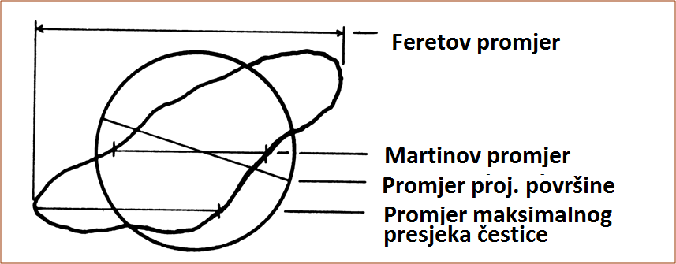
DIAMETERS OF THE PARTICLES IN THE PLANE
Ferret´s diameter
Martin's diameter
Diameter of proj. surfaces
Maximum particle diameter of the particle

Slide 17
EQUIVALENT DIAMETERS
The diameter of the equivalent sphere we can base it on the basis of:
Projected surface area – the diameter of the sphere equal to the projected surface like particles investigated (optical detectors – light scattering)
The surface of the sphere - the sphere diameter equal to the surface like particles investigated (total area of the aerosols, adsorption of gases)
The volume of the sphere - the diameter of a sphere of equal volume, such as the examined particles
The masses of the sphere- the diameter of a sphere of mass equal to the mass of the test particles

Slide 18
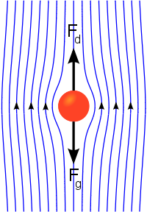
SPEED OF DEPOSITION
Terminal velocity dive particles in the air due to gravity, called yet and at the speed of deposition of, is achieved at the annul gravity with installed and force of friction.

Slide 19
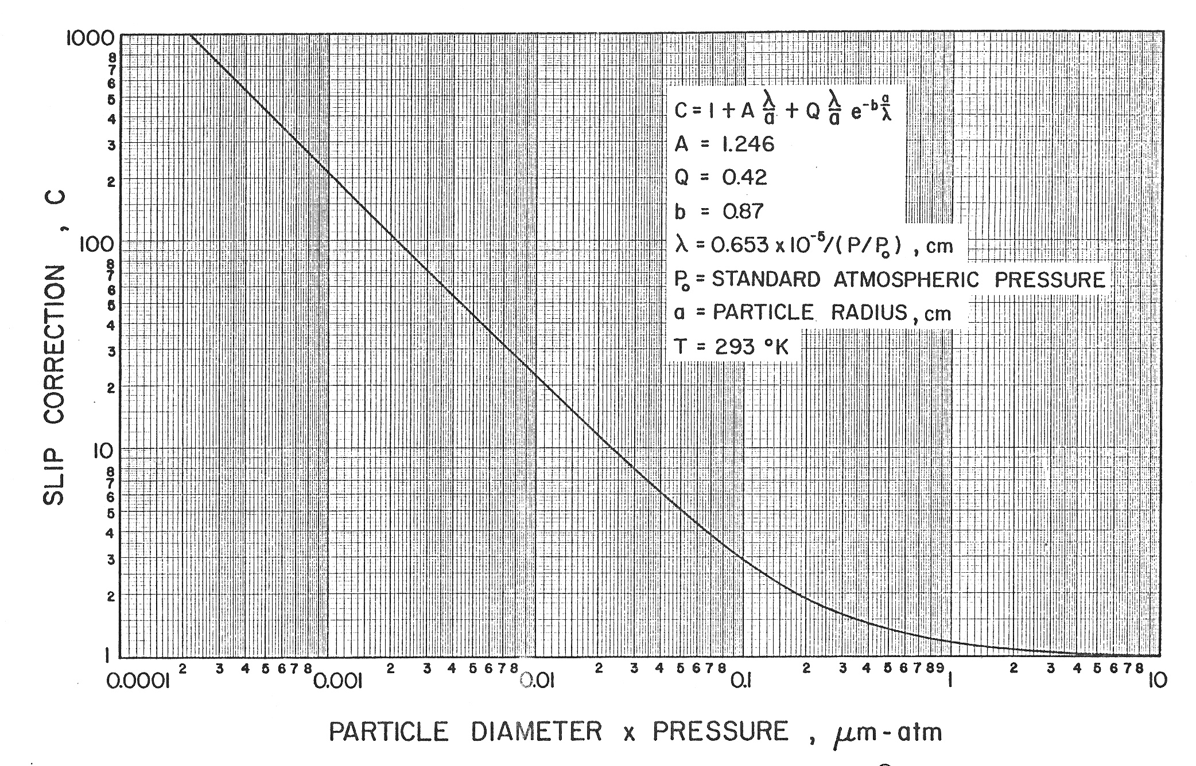
SPEED OF DEPOSITION

Slide 20
EQUIVALENT DIAMETERS
Diameters based on speed of deposition :
Stokes diameter– the diameter of the sphere that has the same speed of precipitation as well as the observed particles.
Aerodynamic diameter- the diameter of a sphere of unit density that has the same speed of precipitation as well as the observed particles.

Slide 21
ADDITIONAL TYPES OF PARTICLE DIAMETER
For special purposes are used more and diameters are based on:
Electrical mobility
The scattering of light
Rather than diffusion – THERMODYNAMIC DIAMETER
etc.
The use of different types of diameter gives different results, therefore, it is necessary to always indicate which species is the diameter used.
In gathering, the analysis and interpretation of results of monitoring airborne particulate matter, which is the primary purpose of the budget of the health effects, always use the aerodynamically particle diameter, because he best describes the behavior of particles.

Slide 22
THE RANGE OF THE SIZE OF THE PARTICULATE MATTER
Range of diameter 0.002 – 100 µm
The ratio of the diameter 1 : 10⁵
The ratio of the surface 1 : 10¹⁰
The ratio of the volume (mass)1 : 10¹⁵

Slide 23
THE CONCENTRATION OF PARTICULATE MATTER
The number concentration– the number of particles in a unit volume of air. It is used most when studying the health benefits of insoluble particles (number of particles deposited within the respiratory system)
Mass concentration– the mass of the particles in a unit volume of air. It is used most when investigating the health effects of toxic soluble particles (mass of particles deposited in the respiratory system)

Slide 24
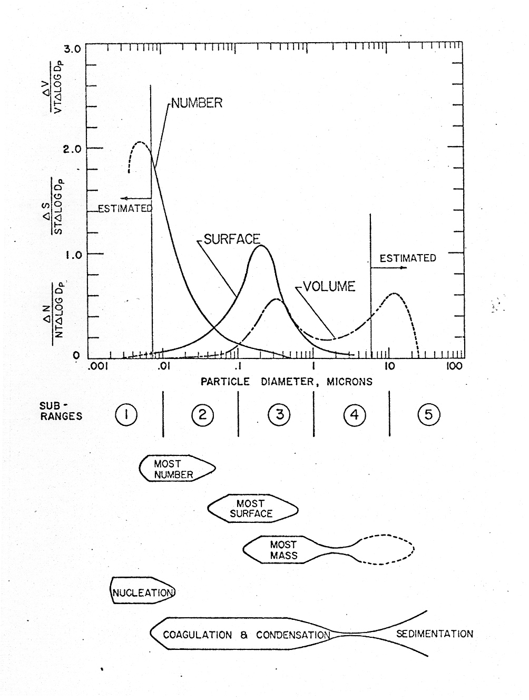
PARTICULATE MATTER IN ENVIRONMENTAL AIR
Small ratio~ 10⁻⁵
Typical for the number, surface and volume of the distribution by size of particles
A rough dvision into three categories:
nucleation mode : ~ 0,01 – 0,04 µm
Accumulation mode: ~ 0,1 – 1µm
Large particles: ~ 5 – 50 µm

Slide 25
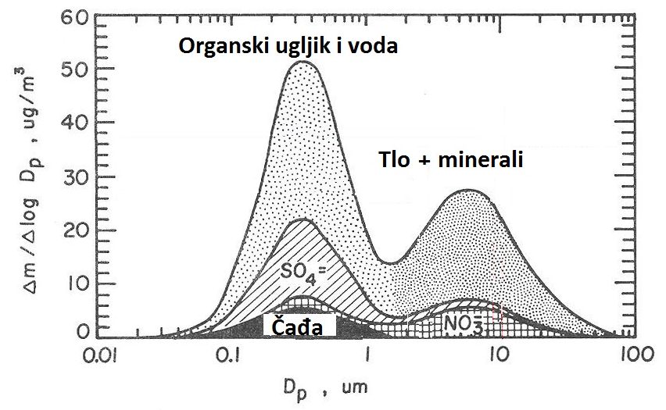
TYPICAL COMPOSITION OF PARTICULATE MATTER
organic carbon and water
Soil + minerals

Slide 26
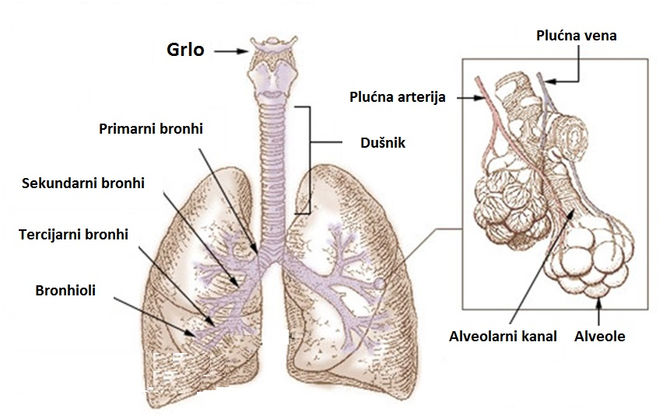
SCHEMATIC VIEW OF THE RESPIRATORY SYSTEM
Pulmonary vein
throat
Pulmonary artery
primary bronchi
trachea
secundary bronchi
tertiary bronchi
bronchioles
alveolar duct
alveoli

Slide 27
DEFINITIONS OF THE FRACTION OF THE PARTICULATE MATTER
For many years, they collected samples (TSP-total Suspended Matter). The results of mass concentration and their compositions are significantly different with respect to the design of an entrance area collector who was not standardized. In this way of comparing the level of pollution particulates from different locations were difficult, or the disabled. Linkage with health effects has also been harder to observable.
HRN ISO 7708:1998 The definitions of the faction of the particles by size for sampling works on health impact assessments(ISO 7708:1995)
Inhalation faction: mass fraction of total suspended particles that we inhale on the nose or mouth (depends on the direction and speed of the air flow, frequency of inhalation, etc.)
Inhalation convention: target specification of inhaled factions.
Extrathoracic fraction : mass concentration of inhaled particles that do not penetrate deeper than the throat.
Extrathoracic convention: target specification sampler extrathoracic factions.

Slide 28
DEFINITIONS OF THE FACTION OF THE PARTICULATE MATTER
Thoracal fraction: mass fraction of suspended particles that reach below the throat.
Toracal convention: the target specimen of the inhaler fractional sampler (given the existence of large differences between individuals, this convention represents an average value). It is described by a cumulative lognormal distribution with a median of 11.64 μm and a geometric standard deviation of 1.5.

Slide 29
DEFINITIONS OF THE FACTION OF THE PARTICULATE MATTER
Tracheobronchial fraction: mass fraction of particulate matter penetrating lower than the throat, but not penetrating the areas without a ciliaar epithelium.
Tracheobronchial convention:the target specification of tracheobronchial fraction samplers (given the existence of large differences between individuals, this convention represents an average value).

Slide 30
THE DEFINITIONS OF THE FRACTION OF THE PARTICULATE MATTER
Respirable fraction: mass fraction of airborne particles that penetrate into the area without the ciliary epithelium.
Respirable convention: the target specimen of the respirable fractionator (given the existence of large differences between individuals, this convention represents an average value). It is described by a cumulative lognormal distribution with a 2.5μm median geometric standard deviation of 1.5.

Slide 31
THE DEFINITIONS OF THE FRACTION OF THE PARTICULATE MATTER
Each of the above convention, approximating the faction suspended particles that penetrate in a particular region of the respiratory system, not a faction that is deposited in that region.
In this sense, the above-mentioned convention to overestimate their health effects, because we assume that them can cause only deposited particles.

Slide 32
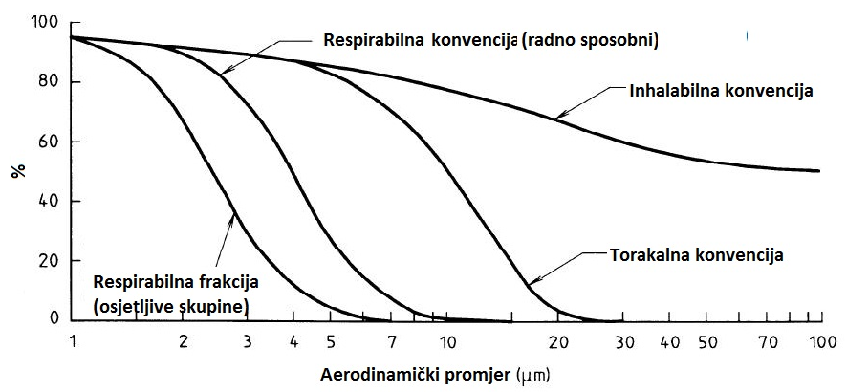
GRAPHICAL REPRESENTATIONS OF THE CONVENTION
respirable convention: workable
inhalable convention
thoracic convention
respirable fraction (sensitive groups)
aerodynamic diameter

Slide 33
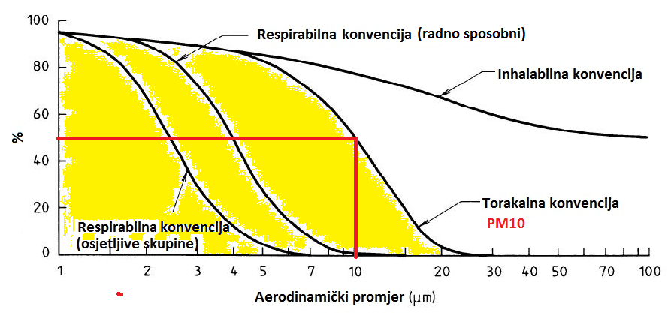
GRAPHICAL REPRESENTATIONS OF THE CONVENTION
respirable convention: workable
inhalable convention
thoracic convention
respirable fraction (sensitive groups)
aerodynamic diameter

Slide 34
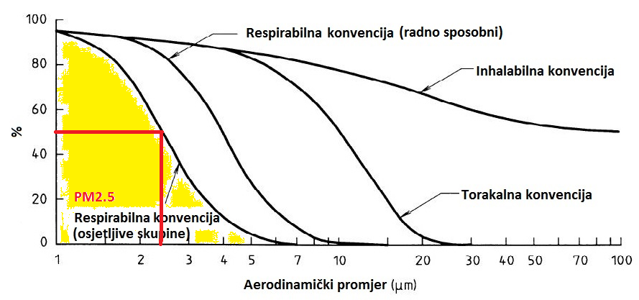
GRAPHICAL REPRESENTATIONS OF THE CONVENTION
respirable convention: workable
inhalable convention
thoracic convention
respirable fraction (sensitive groups)
aerodynamic diameter

Slide 35
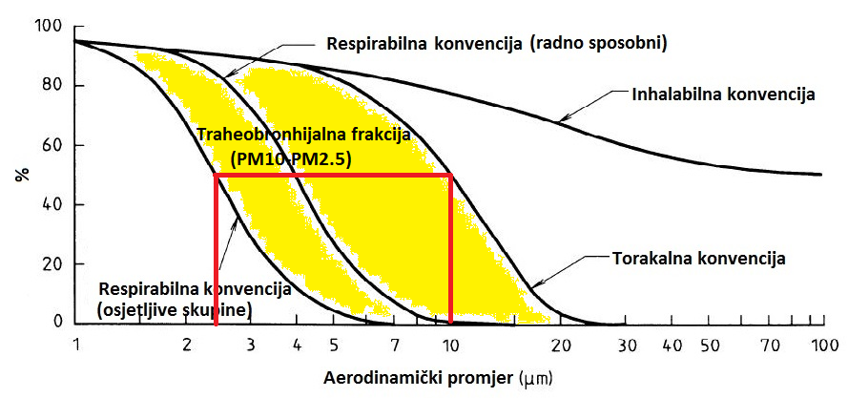
GRAPHICAL REPRESENTATIONS OF THE CONVENTION
respirable convention: workable
inhalable convention
Tracheobronchial fraction
thoracic convention
respirable fraction (sensitive groups)
aerodynamic diameter

Slide 36
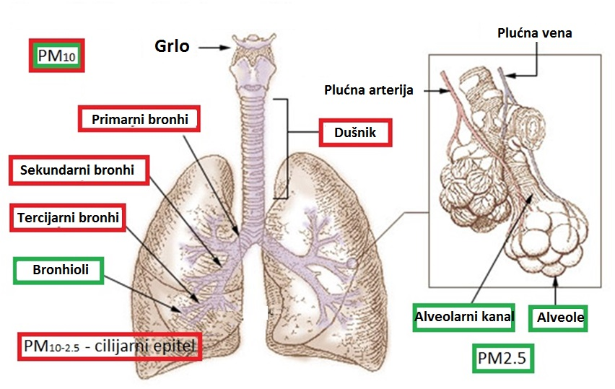
THE CONVENTION – ANATOMICAL VIEW
Pulmonary vein
throat
Pulmonary artery
primary bronchi
trachea
secundary bronchi
tertiary bronchi
bronchioles
alveolar duct
alveoli

Slide 37
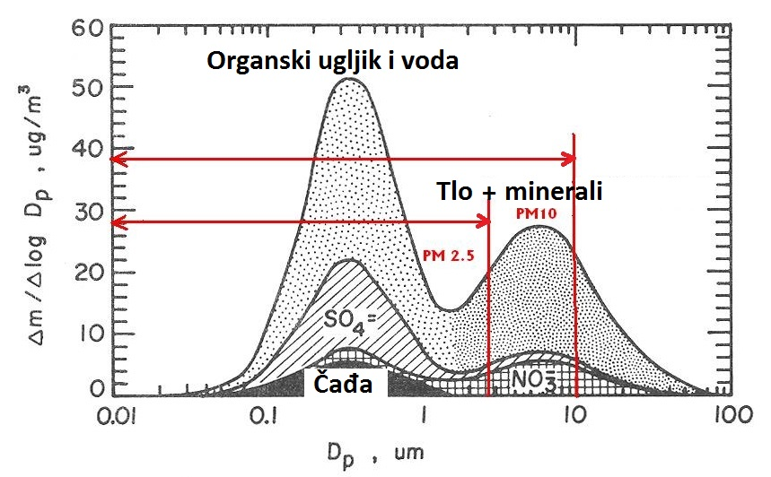
TYPICAL COMPOSITION of PM10, PM 2.5 and PM10-2.5 FRACTION PM
organic carbon and water
Soil + minerals
soot

Slide 38
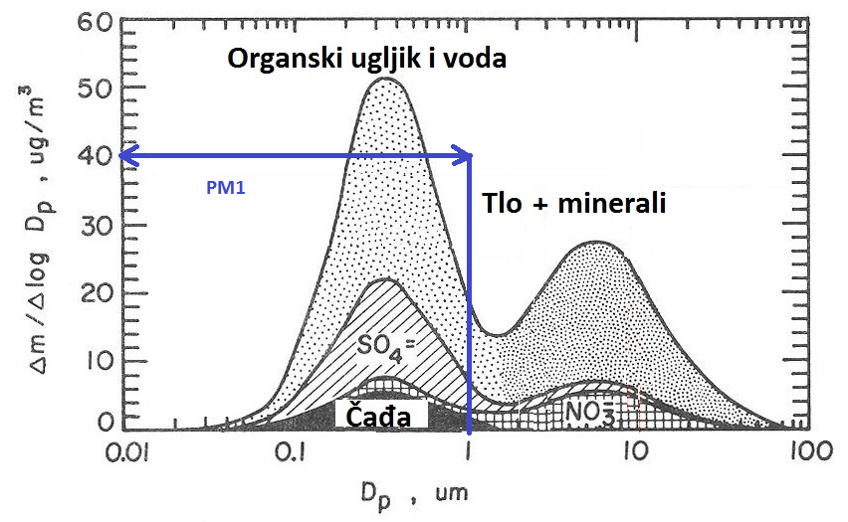
TYPICAL COMPOSITION OF THE PARTICULATE FRACTIONS OF PM1
organic carbon and water
Soil + minerals
soot

Slide 39
EXAMPLES OF MONITORING PARTICULATE MATTER
Measurement of automatic Analyzers (in situ analysis)
Advantages:
Getting the results in real time (validation required)
The abundance of data allows for a good statistical processing of the results
Allows you to track short term variations
Disadvantages:
Complex and expensive
The necessary frequent calibration
Very limited or impossible chemical analysis of samples

Slide 40
EXAMPLES OF MONITORING PARTICULATE MATTER
SAMPLING AND SUBSEQUENT ANALYSIS
Advantages:
Time-integrated pattern that gives the average value
Much of the material for analysis
Simpler instruments, of easily adaptable
Suitable for a wide range of chemical analysis
Disadvantages:
The particles can be agglomerate
The possibility of chemical reactions between particles, or between particles and base
Possible errors when sampling and transport of samples

Slide 41
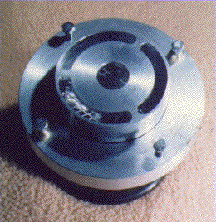
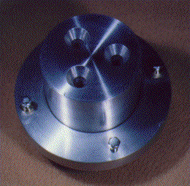
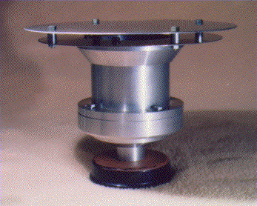
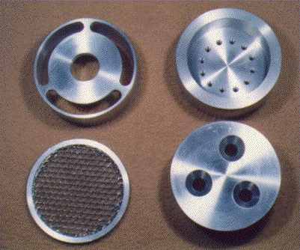
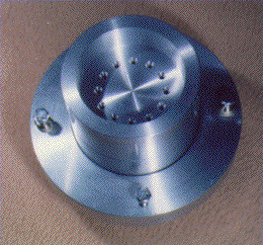
EXAMPLES OF PARTICULATE FRACTION COLLECTORS
“Homemade production“
PM10 i PM2.5
Inlet separators(1998.)
The volume of the sample:
~ 100 m³ /dan
The diameter of the nozzle:
11 mm i 2.5 mm
The number of nozzles:
3 i 12
Reynolds number: ~ 3 000

Slide 42
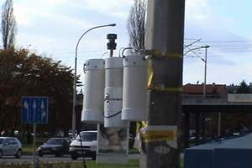
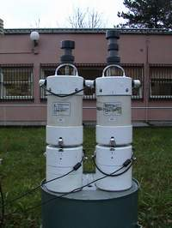
EXAMPLES OF PARTICULATE FRACTION COLLECTORS
AirMetrics collectors
Suitable for ad hoc and interim surveys in the vicinity of the industry and roads.
Power supply: 220 V AC ; 12 V DC
Fractions of particles: PM10 i PM2.5
Programmable: time, day, day of week, etc.
It is easily mounted on pillars, trees, walls, fences etc.
A strong pump, air flow rate 5 L/min
The possibility of collecting gases in bags of Tedlara of up to 8 h

Slide 43
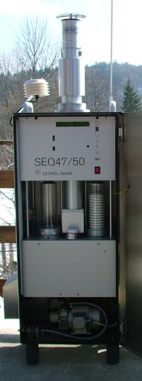
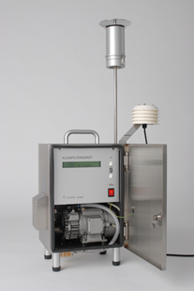
EXAMPLES OF PARTICULATE FRACTION COLLECTORS
Reference collectors
Fractions: PM10,PM2.5, PM1
The number of nozzles: 8
The flow of air: 2.3 m³h⁻¹
Filter types:
Quartz, teflon, glass fibers
LVS3
SEQ47/50

Slide 44
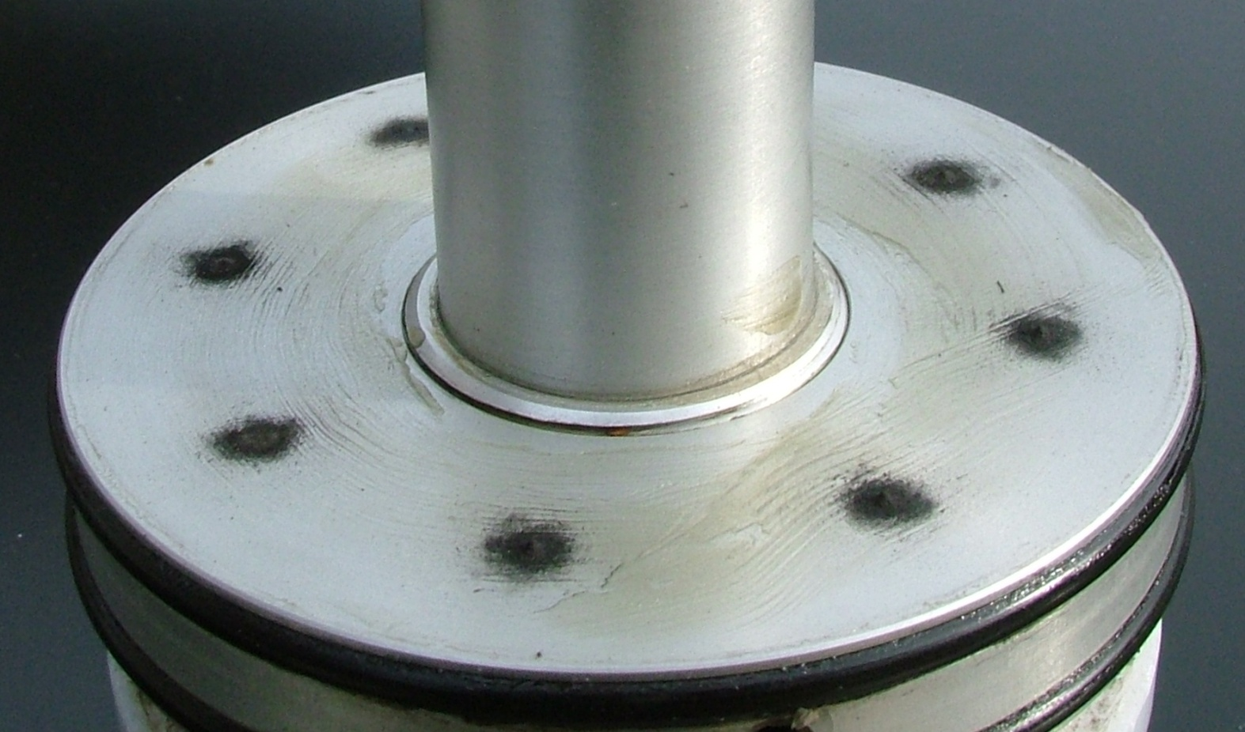
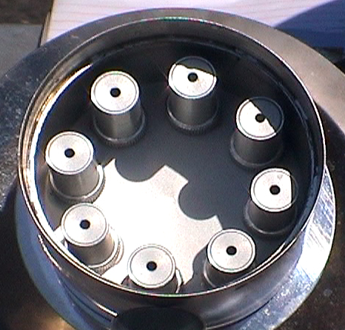
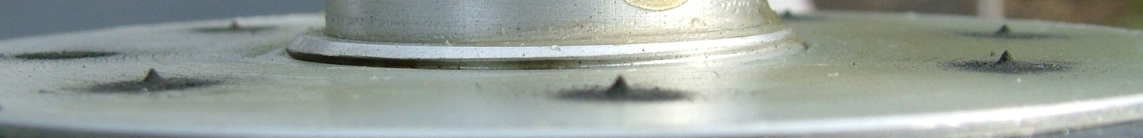
EXAMPLES OF PARTICULATE FRACTION COLLECTORS
Nozzles and Impact base (PM2.5)

Slide 45
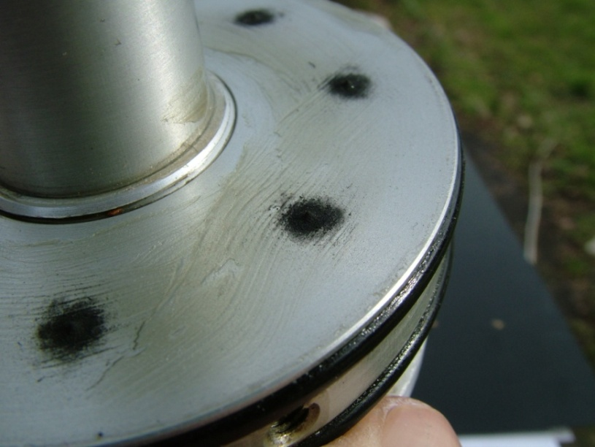
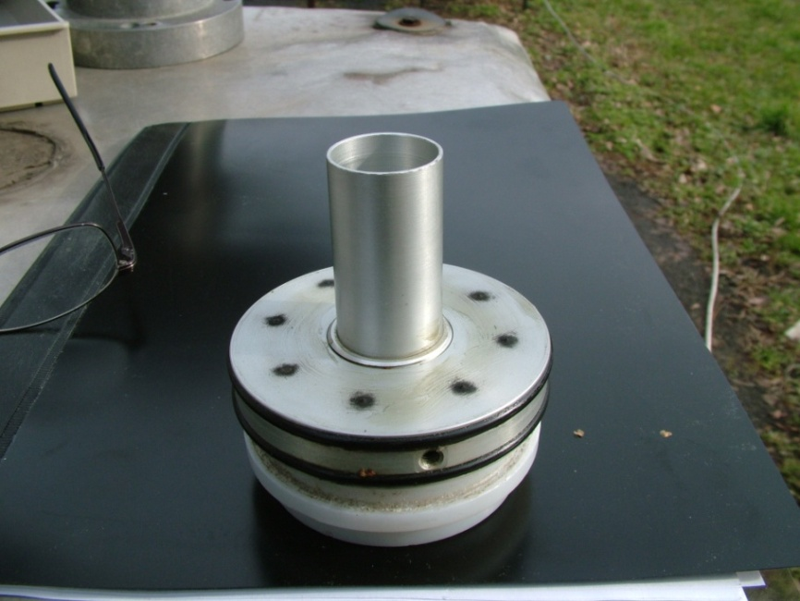
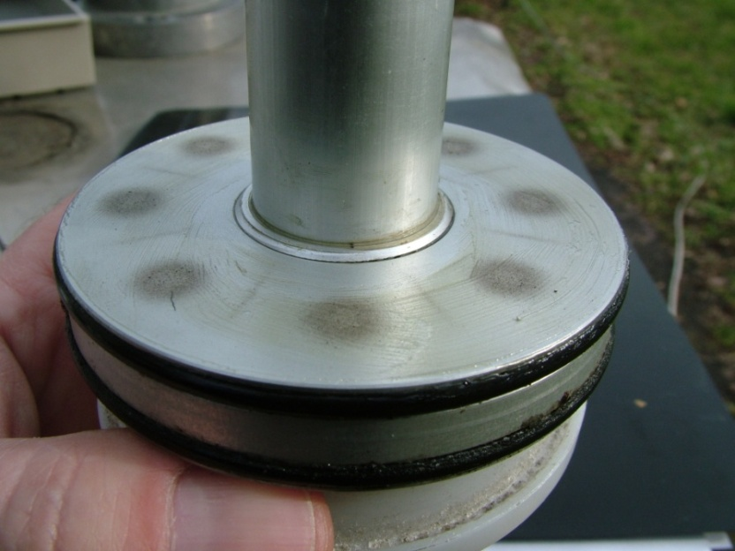

EXAMPLES OF PARTICULATE FRACTION COLLECTORS

Slide 46






EXAMPLES OF PARTICULATE FRACTION COLLECTORS

Slide 47







EXAMPLES OF PARTICULATE FRACTION COLLECTORS
Digitel HVS Automat DHA-80
15 filter diameter150 mm
The factions: PM10 ili PM2.5
The flow of air:
Total PM : 700 L/min (1008 m³ dan⁻¹)
PM10, PM2.5: 500 L/min ( 720 m³ dan⁻¹)

Slide 48


EXAMPLES OF AUTOMATIC ANALYZERS
TEOM - Tapered element
oscillating microbalance
Measures the change in the frequencies of the vibration caused by the increase in the mass of collected particles.
Beta Gauge Particulate Monitor
Measures the β-air attenuation at passing through the sample collected particle.
TEOM
β - gauge

Slide 49


THE FILTER BASE
Teflon PTFE filters are:
Strong and resistant to acids, alkalis and solvents
Hydrophobic
Very clean, suitable for chemical analysis
Suitable for gravimetric analysis
Resistant up to 260 ° C
Ideal for collecting airborne particulate matter, especially in a damp environment.
When weighing the need to the electrostatic break out
The high price

Slide 50
THE FILTER BASE
Quartz fibers filters
Suitable for research on air pollution.
Made of pure (SiO2) Microfiber (QMA), no binders or additives.
Very low contents of alkaline metals.
The separation of particles: efficient separation of small particles.
Permeability: very high. Allows large flow rates of air.
Kemijska stabilnost: very stable in the presence of acidic gases (HCl, SO2, SO3, H2SO4, NO and NO3).
Resistance to the chemical reagent: resistant to acids (except HF) and bases.
Temperature stability: more resistant than filters, consisting of glass fibre. Resistant up to 950 ° C; above these temperatures are starting to lose their good properties.

Slide 51






THE FILTER BASE
Quartz fibers filters

Slide 52


THE FILTER BASE
There are three basic mechanism of separation of particles from air currents in fibrous filters:
Diffusion
Interception
Impaction
The total efficiency of the filter is the sum of the efficiency of these mechanisms, the separation of the particles.
Minimum efficiency (the biggest passage of particles) is for particles with diameter of 0.2 – 0.3 µm and the efficiency of the filters are always measured in the area size.

Slide 53
MONITORING OF PARTICULATE MATTER
Air Protection Act
Narodne novine 130/11, 47/14, 61/17
The regulation on the levels of pollutants in the air Narodne novine 117/12
Regulation on air quality monitoring
Narodne novine 79/17
Regulation on the determination of the zones and agglomerations according to the levels considerable pollution of the air in the territory of the Republic of Croatia Narodne novine 1/14
The program of pollution level measurement of the air in the State network for permanent monitoring of air quality
Narodne novine 73/16

Slide 54
MONITORING OF PARTICULATE MATTER
HRN EN 12341:2006
Withdrawn
Air quality--determination of the PM10 fractions by size of the suspended particles--the reference method and field testing for the purpose of proving equivalence measurement methods (EN 12341:1998)
HRN EN 14907:2006
Withdrawn
The quality of the outside air--a standard gravimetric method for the determination of the PM2, 5 mass fraction of airborne particles (EN 14907:2005)
These norms are withdrawn 2014. year and merged into an improved standard:
HRN EN 12341:2014
Outdoor air--determination of the mass concentration of suspended particulate matter PM10 ,PM2, 5 with standard gravimetric method (EN 12341:2014)

Slide 55
MONITORING OF PARTICULATE MATTER
Finally, what kind of sample we have in the end?
The sample is collected in accordance with the expected health effects to the selected convention.
We're collecting the integrated sample through the defined period of collecting.
Particles are accumulated closely so the possible chemical reactions between particles, as well as between the particles and the surface.
Due to the norm EN 12341:2014 prescribed conditioning samples terms of air temperature, air pressure and relative humidity are altered in relation to the environmental conditions so permit the evaporation and condensation of water and volatile substances.
During the conditioning the samples were exposed to the settlement: and the absorption of substances from the air chambers for conditioning and weighing room (eg. burned conditioning filters for collecting organic and carbon-elementary).

Slide 56
MONITORING OF PARTICULATE MATTER
Collected sample is significantly different from "the cloud particles" from which it was taken, so it raises the question of what we accomplished with the default procedures?
Uniformity procedure which allows the comparison of the results obtained by the "around the world".
A good base for further statistical analysis.
The possibility of conducting uniform epidemiologic studies and meta studies.
Planning and implementation of uniform and simultaneous measures to reduce pollution levels.
The unique legislative
Unique control levels of air pollution.

Slide 57
MONITORING OF PARTICULATE MATTER-EQUIVALENCE
Testing equivalence of results (PM 2.5) – example 1
A comparison of the original and the seasonally corrected data of certain reference SEQ47/50 by collector and automatic analyzer for the PM 2.5 fraction during 2014. and 2015.
Original data | Corrective data | Corrective function
Winter ; N = 90 ; R² = 0,935
y = 0,699x + 1,880 U = 76,2 % | y = 1,012x – 0,705 U = 89,2 % | y₁ = 1,430y – 2,688
Spring ; N = 91 ; R² = 0,804
y = 0,591x + 0,747 U = 77,5 % | y = 1,058x – 0,840 U = 30,4 % | y₁ = 1,692y – 1,264
Summer ; N = 92 ; R² = 0,627
y = 0,512x + 1,826 U = 85,7 % | y = 1,173x – 2,663 U = 48,3 % | y₁ = 1,954y – 3,569
Autumn ; N = 89 ; R² = 0,945
y = 0,670x + 1,173 U = 74,5 % | y = 1,011x – 0,596 U = 73,5 % | y₁ = 1,492y – 1,750
Year period; N = 362 ; R² = 0,954
y = 0,704x – 0,289 U = 75,1 % | y = 1,008x – 0,290 U = 61,9 % | y₁ = 1,420y + 0,411

Slide 58


MONITORING OF PARTICULATE MATTER-EQUIVALENCE
Testing equivalence of results (PM 2.5) – example 1
Reference method | No-reference methods | Annual correction | Seasonal correction
C = 35,6 µg/m³ | C = 24,8 µg/m³ | C = 35,6 µg/m³ | C = 35,6 µg/m³

Slide 59
MONITORING OF PARTICULATE MATTER-EQUIVALENCE
Testing equivalence of results (PM 2.5) – example 2
A comparison of the original and the seasonally corrected data of certain reference SEQ47/50 collector and automatic analyzer for the PM10 fraction
Original data | Corrective data | Corrective function
Summer; N = 27 ; R² = 0,929
y = 1,018x + 1,113 U = 10,2 % | y = 0,999x + 0,009 U = 12,9 % | y₁ = 0,983y – 1,094
Autumn ; N = 28 ; R² = 0,956
y = 0,998x + 0,820 U = 6,9 % | y = 1,000 – 0,001 U = 10,9 % | y₁ = 1,002y – 0,821
Winter; N = 45 ; R² = 0,926
y = 0,843x + 2,821 U = 22,4 % | y = 1,007x – 0,138 U = 13,9 % | y₁ = 1,187y – 3,348
Spring; N = 30 ; R² = 0,950
y = 0,947x + 0,792 U = 11,1 % | y = 1,001x – 0,029 U = 12,5 % | y₁ = 1,055y – 0,836

Slide 60
MONITORING OF PARTICULATE MATTER-EQUIVALENCE
Testing equivalence of results (PM 2.5) – example 3
A comparison of the original and corrected data of certain reference SEQ47/50 collector and collector Digitel HVS Machine the DHA-80 for the PM10 fraction
After correction of the number of daily overdrafts increased by ~ 50% (35 allowed)
Reference LVS vs. HVS ; N = 125 ; R² = 0,968
Original data | Corrective data | Corrective function
y = 0,892x – 3,133 U = 37,2 % | y = 1,002x + 0,357 U = 16,9 % | y₁ = 1,122y + 3,514
Parameter | Reference LVS | HVS | Annually corrected HVS | Seasonally corrected HVS
C_{avg} [µg m⁻³] | 38,3 | 31,1 | 38,3 | 38,3
> 50 [µg m⁻³] | 83 | 56 | 80 | 83

Slide 61
MONITORING OF PARTICULATE MATTER
Display uniformity clouds PM10
Comparison of daily concentrations measured during 2016, with the same collectors at two city metering stations located in different parts of the city are distant from each other 4.7 km airline.

Slide 62
MONITORING OF PARTICULATE MATTER-EXAMPLE 1
Monitoring the PM2, 5, on particulate fractions of urban background measurement station
Measuring period 2000.0-2015.
Measurements carried out in accordance with the prescribed standards
The coverage of data > 98%
Daily patterns (from noon to noon)
Used reference devices: LVS3, SEQ 47/50

Slide 63



MONITORING OF PARTICULATE MATTER-EXAMPLE 1
Years | Measured concentration (annual average) | GV increased for GT
 | µg m⁻³ | (µg m⁻³)
2009. | 25,4 | 29,3
2010. | 25,0 | 28,6
2011. | 26,5 | 27,9
2012. | 21,7 | 27,1
2013. | 22,5 | 26,4
2014. | 19,3 | 25,7
2015. | 21,8 | 25,0
2020. GV=20 µg m⁻³

Slide 64

MONITORING OF PARTICULATE MATTER-EXAMPLE 1
A prominent seasonal dependence

Slide 65


MONITORING OF PARTICULATE MATTER-EXAMPLE 1

Slide 66

MONITORING OF PARTICULATE MATTER-EXAMPLE 1
Trends of seasonal concentration through the measuring period

Slide 67

MONITORING OF PARTICULATE MATTER-EXAMPLE 1
Trends of concentrations for the periods without (May-September) and with heating (November-March)

Slide 68


MONITORING OF PARTICULATE MATTER-EXAMPLE 1
An indicator of average exposure (PPI) a three-year average of the annual mean concentrations of backwards: PPIX = (CX + CX-1 and CX-2)/3
The value of the PPI for 2015. of 21.2 µ g m-3 is higher than the required level of exposure from 20.0 µ g m-3 for 2015.
The model was given an excellent prediction value of PPI for 2015.
Prediction for 2020. year is 19.4 µ g m-3. If the prediction comes true, it would mean that the exposure reduction target at the national level of 20% will not be reached.

Slide 69


MONITORING OF PARTICULATE MATTER-EXAMPLE 1
The average three-year dependance the number of additional cases of total mortality (ΔDS) with regard to the change in PPI.
The budget shows that during the period of 2001. up to 2015. ∆DS is reduced from 3,2 #100 000 for 2001. to 1,4 #/100 000
Residents for 2015. evaluation ∆DS
for 2020. is 1,2 #/100 000 inhabitants.

Slide 70
MONITORING OF PARTICULATE MATTER-EXAMPLE 2
Observation of colored precipitation when sediment analysis indicates the presence of a Sahara dust is rare inland Croatia. Most of these events pass unnoticed, and it is only possible to prove a complex analysis of elemental composition of particulate and modeling the existence and strength of the individual sources of pollution.
Type of pollution: 24-hour samples PM2.5
The number of samples: 619
The filter base: PTFE
Measurement methods: HRN EN 14907:2005; HRN EN 12341:2014
Measurement period: 20. January 2014. – 30. September 2015.
Sampler: SvenLeckel SEQ47/50
Elemental analysis: ED XRF
The Analyzer: EPSILON5, PanAnalytical
Analysis of results: EPA PMF5; NOAA HYSPLIT

Slide 71





MONITORING OF PARTICULATE MATTER-EXAMPLE 2
The analysis has highlighted the six important factors (sources of pollution PM 2.5 fraction of airborne particles). Factor 4 which we can call a Saharan dust is completely independent and does not show dependence on other factors (the rotation of the factors shows no effect)
Orthogonal Factor 4 on other factors

Slide 72




MONITORING OF PARTICULATE MATTER-EXAMPLE 2
Si
Ti
Al
Ca
Arrenged modelled with measured values for Si, Ti, Al and Ca

Slide 73





MONITORING OF PARTICULATE MATTER-EXAMPLE 2
The percentage of single element included in the Factor 4

Slide 74

MONITORING OF PARTICULATE MATTER-EXAMPLE 2
The results show that in Zagreb every occurrence of the trajectory of the air originating from the North of Africa (30-40 per year) has been registered as a contribution to the content of the PM 2.5 fraction of airborne particles, representing the transport of pollution from the Sahara desert in Central Europe.
The survey was conducted as part of the project IAEA RER1/013 TC project “Supporting Air Quality Management (Phase II)

Slide 75
THANK YOU FOR YOUR ATTENTION !
Disclaimer: The contents of this publication are the sole responsibility of EKONERG – Energy Research and Environmental Protection Institute, Ltd. and can in no way be taken to reflect the views of the European Union
This project is funded by the European Union

